Slide 1
Entwicklung einer Digital Twin-Applikation für einen Industrieroboter mit ROS und OPC-UA
Ahmed Ibrahim Almohamed
ibraah0@thu.de

Slide 2
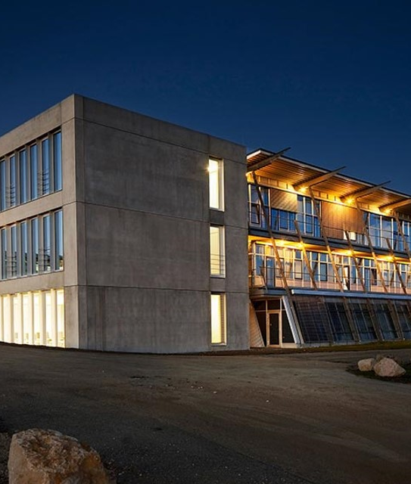
Agenda
Introduction
Use case Application
Current state of the system
System overview
Timeline
Conclusion

Slide 3
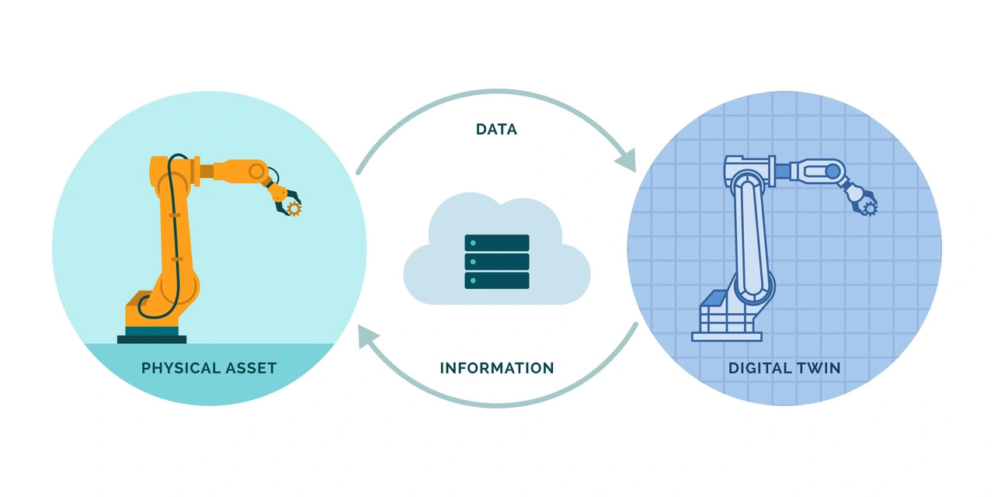
Introduction
Digital Twin
Notes:
What is a DT ?
represents the creation of a virtual replica of a physical object or system that is used to simulate, monitor, and optimize its real-world counterpart.

Slide 4
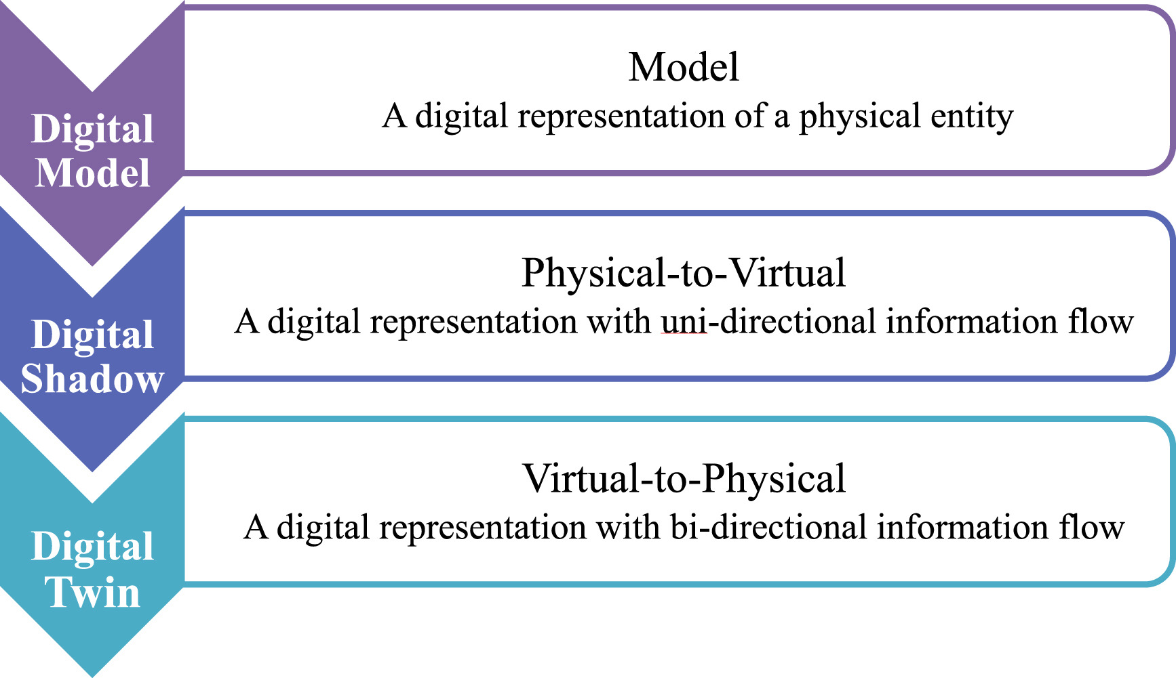
Introduction
Level of Integration
Notes:
Layers of integration :
Mirroring or Digital Model involves the creation of an exact virtual replica of a physical object or system in real-time
Shadowing focuses on continuously updating the digital twin with real-time data from its physical counterpart

Slide 5
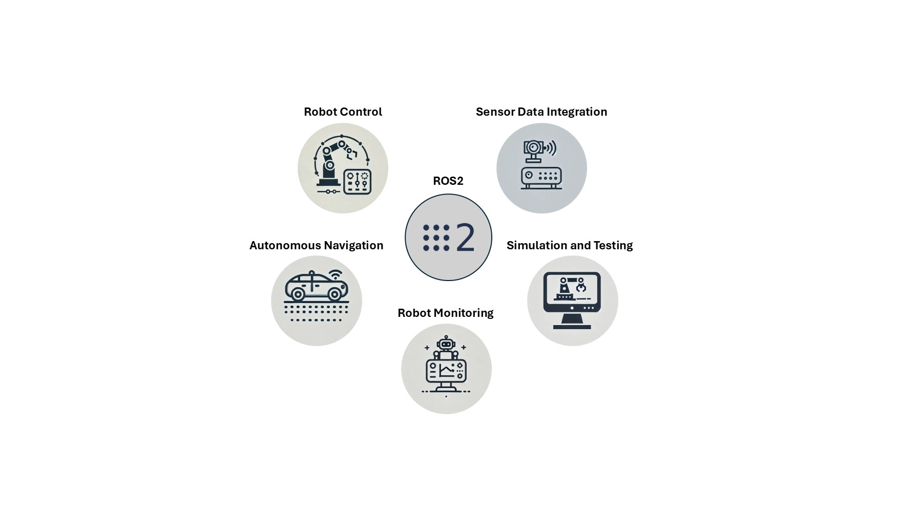
Introduction
ROS2
Notes:
What is ROS2 :
is an open source software development kit for robotics applications
The Robot Operating System (ROS) is a set of software libraries and tools for building robot applications. From drivers and state-of-the-art algorithms to powerful developer tools,
The purpose of ROS 2 is to offer a standard software platform to developers across industries that will carry them from research and prototyping through to deployment and production

Slide 6
Introduction
ROS2 Nodes
Notes:
ROS2 Nodes :
A node is a participant in the ROS 2 graph, which uses a client library to communicate with other nodes. Nodes can communicate with other nodes within the same process, in a different process, or on a different machine. Nodes are typically the unit of computation in a ROS graph; each node should do one logical thing.
Nodes can publish to named topics to deliver data to other nodes, or subscribe to named topics to get data from other nodes. They can also act as a service client to have another node perform a computation on their behalf, or as a service server to provide functionality to other nodes.

Slide 7
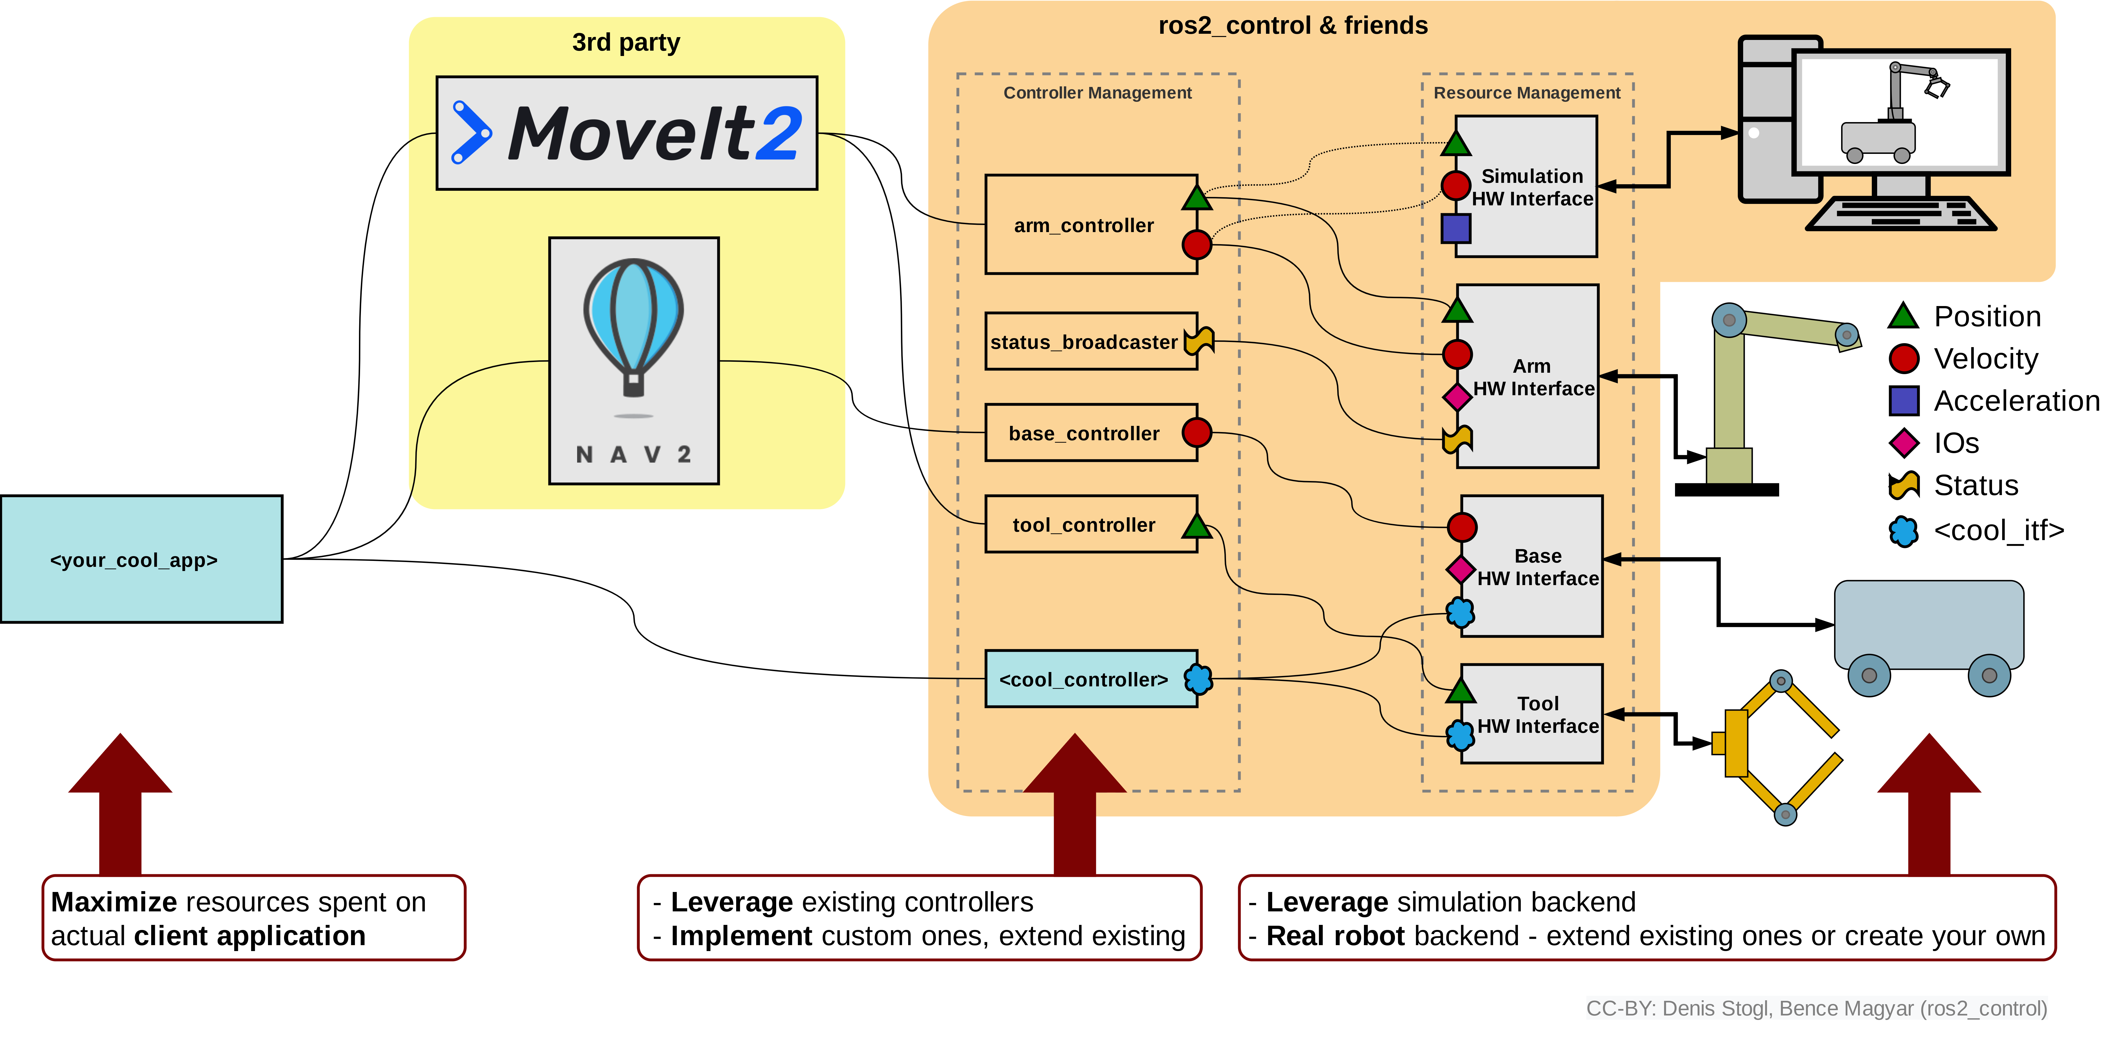
Introduction
ROS2 architecture overview
Notes:
ROS2 Layers :
App Layer : where the high level commands come ( RVIZ or some ros2 node )
3rd party software : like Movit2 for motion planning, manipulation, 3D perception, kinematics, control, and navigation.
Controllers

Slide 8
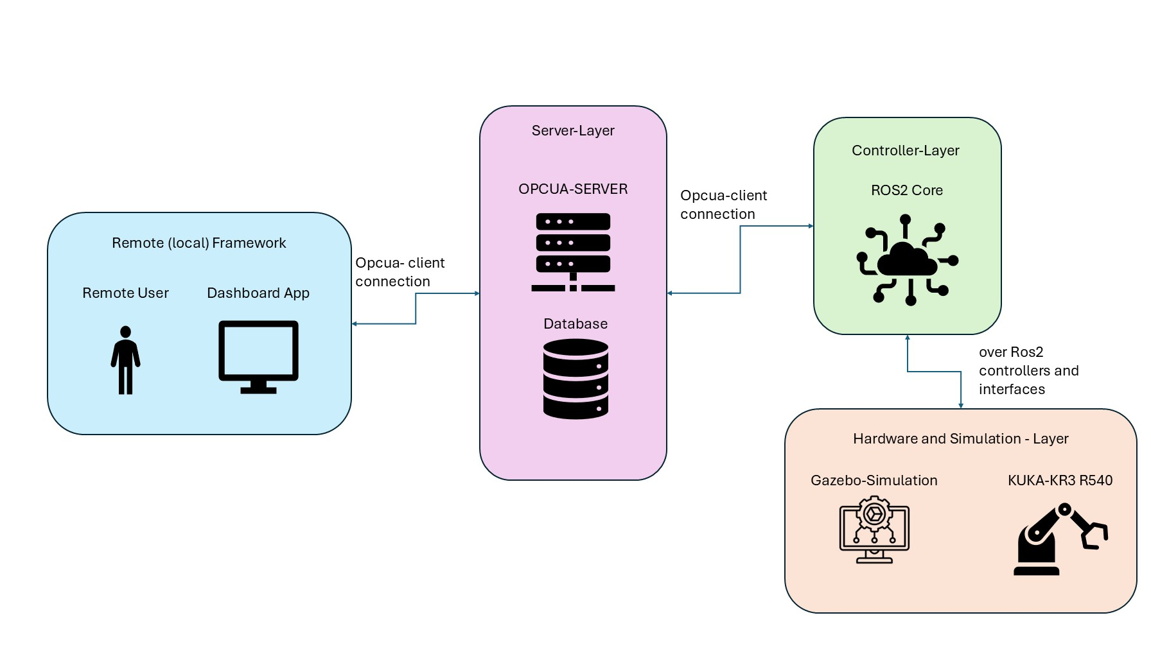
Use case Application
Remote (and local) Monitoring and Control of KUKA robots in the THU robotics lab
Notes:
Usecases overview :
Main components :
Remote frame work : is a dashboard with functionalities to chose the point to move both of the twins (and monitor the simulation)
Server Layer : connect the remote frame work with the controller layer of the system and authenticate the user (and store the user data and system data )
Controller layer : control the hardware layer accordingly to the user interactions and sends back states from the hardware to the user layer
Hardware and Simulation layer : contains the connections to the hardware and the simulation and their own system

Slide 9
Vielen Dank für Ihre Aufmerksamkeit.
www.thu.de

